Slide 1
Duplicate Sentence Identifier
Our goal is:-
To check duplication amongst any two sentences
Analysing common beliefs through sentences
Ease of searching in social media platforms, etc.

Slide 2
Dataset : Quora Question pairs
The goal is to predict which of the provided pairs of questions contain two questions with the same meaning.
Data fields
id - the id of a training set question pair
qid1, qid2 - unique ids of each question (only available in train.csv)
question1, question2 - the full text of each question
is_duplicate - the target variable, set to 1 if question1 and question2 have essentially the same meaning, and 0 otherwise.

Slide 3
Ethical aspect of project :-
In social media platform many people ask similarly worded questions. Multiple questions with the same intent can cause seekers to spend more time finding the best answer to their question, and make writers feel they need to answer multiple versions of the same question. Hence this model identifies similar question/sentences for ease of answering the question.
While checking answer sheets it can find whether two answers are similar or not, can also act like a plagiarism checker.
This model can analyze usage of similar keywords by group of people and understand beliefs and can act as a bridge between organization and common people.
Product with duplicated brand names can also be checked with this model.

Slide 4
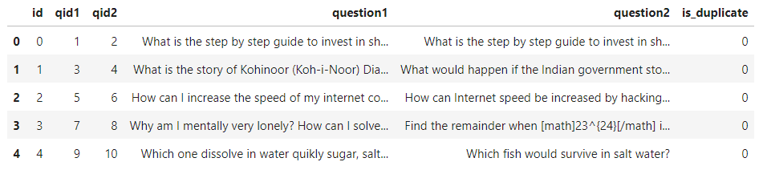


Samples :
True
False

Slide 5
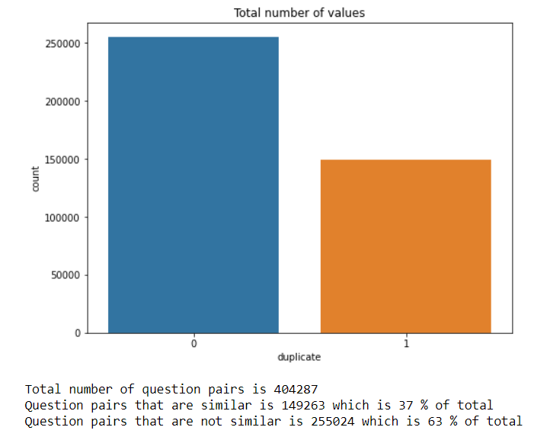
Exploratory Data Analysis
Distribution of Target variable

Slide 6
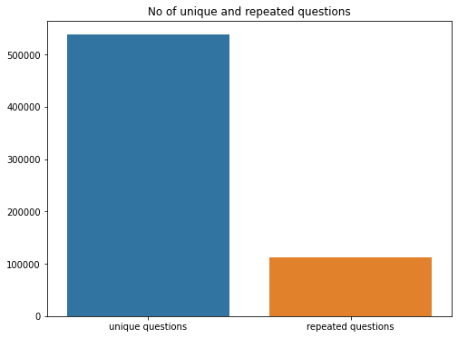
Number of Unique and repeated questions
Total unique questions : 537929
Total repeated questions : 111778 i.e. 20.78 %
Maximum no. of times question occurred : 157

Slide 7
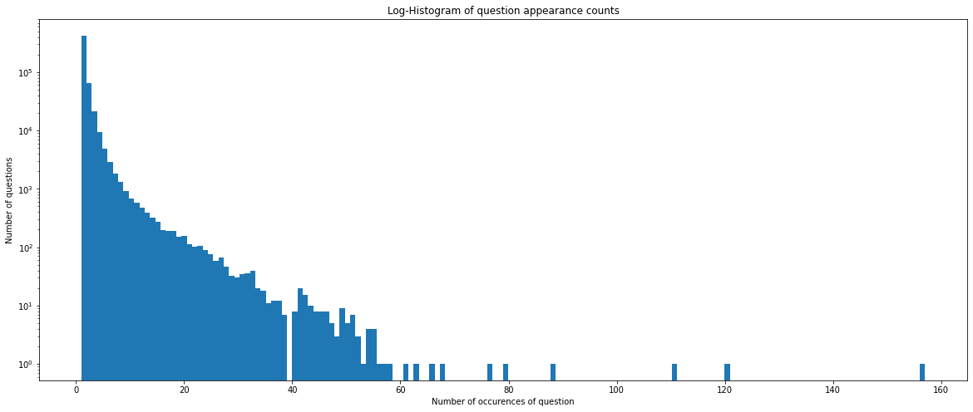
Log – Histogram of question appearance counts

Slide 8
Feature Engineering Adding some new features
word_Common = Number of common unique words in Question 1 and Question 2
word_Total =Total num of words in Question 1 + Total num of words in Question 2
word_share = word_common)/word_Total
freq_qid1 = Frequency of qid1’s i.e, number of times question1 occur
freq_qid2 = Frequency of qid2's

Slide 9
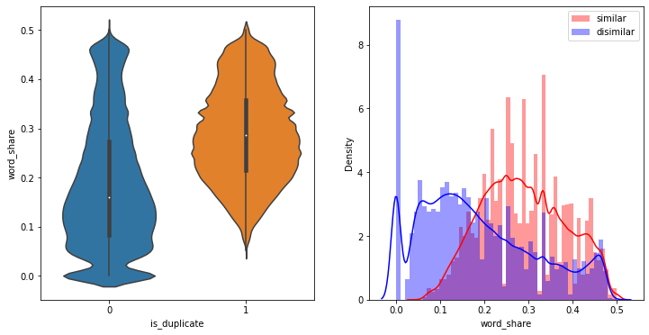
Effect Of Shared words As the word share increases there is a higher chance the questions are similar Histogram word share has some information differentiating similar and dissimilar classes.

Slide 10
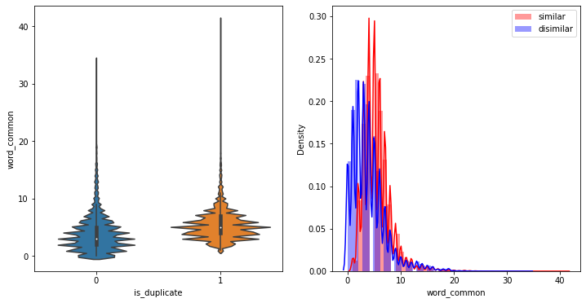
Effect of Common words Common words doesn’t have enough information about differing classes Histogram of duplicate and non-duplicate questions are overlapping.

Slide 11
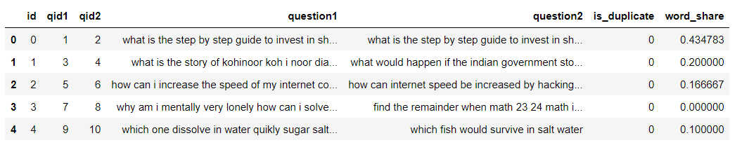
Text Pre-processing : cleaning
Removing punctuations,
performing stemming,
Removing stop-words,
Expanding contractions, replacing “can’t” with “can not”,“$” with" dollar” etc.

Slide 12
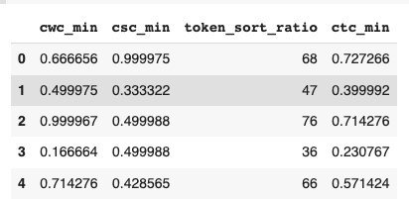
cwc_min : Ratio of common_word_count to min length of word count of Q1 and Q2
common_word_count / (min(len(q1_words), len(q2_words))
csc_min : Ratio of common_stop_count to min length of stop count of Q1 and Q2
common_stop_count / (min(len(q1_stops), len(q2_stops))
ctc_min : Ratio of common_token_count to min lenghth of token count of Q1 and Q2
common_token_count / (min(len(q1_tokens), len(q2_tokens))
token_sort_ratio: In some other cases even fuzz partial ratio will fail.
fuzz.partial_ratio("MI vs RCB","RCB vs MI") ⇒ 72 Actually both the sentence have the same meaning. But the fuzz ratio gives a low result. So a better approach is to sort the tokens and then apply fuzz ratio. fuzz.token_sort_ratio("MI vs RCB","RCB vs MI") ⇒ 100

Slide 13
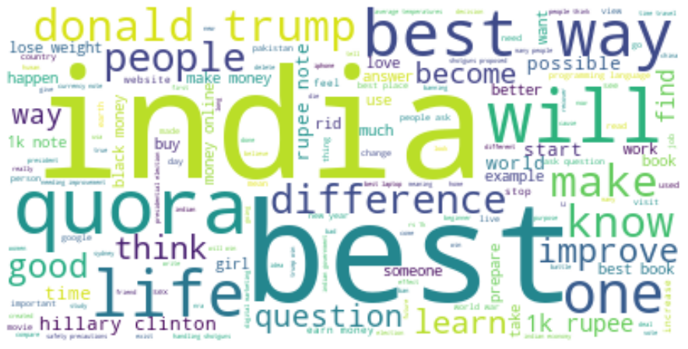
Plotting the Word Clouds : Duplicate pair of questions :

Slide 14
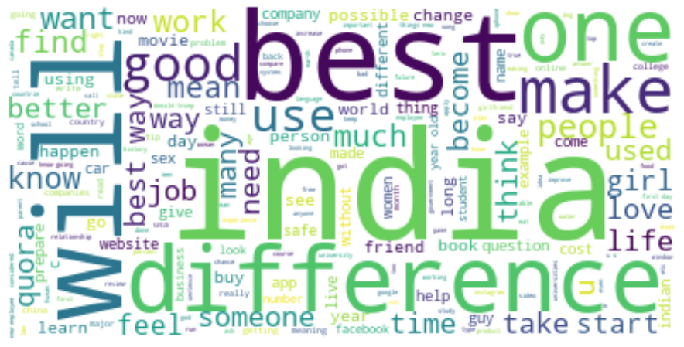
Plotting the Word Clouds :
Non Duplicate Pair of Questions :

Slide 15
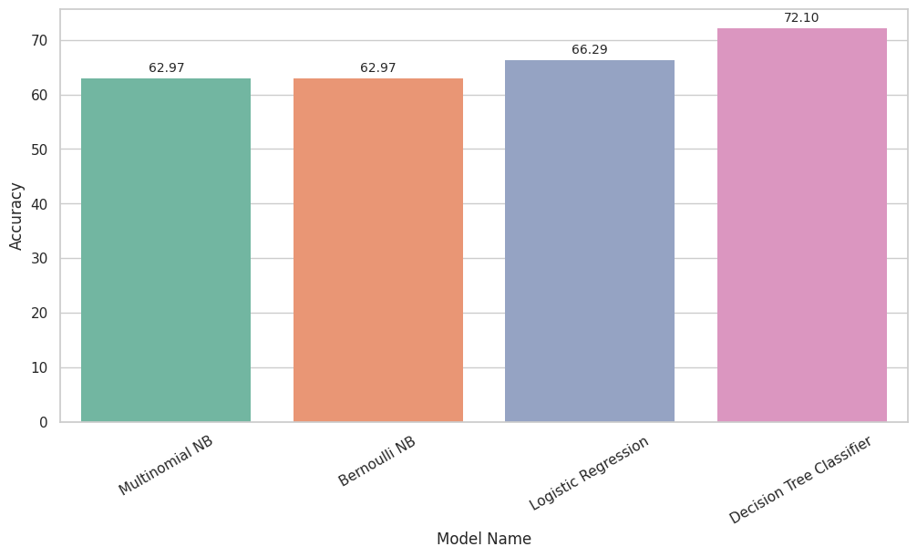
Machine Learning Models :
Training Accuracy comparison of different models:

Slide 16
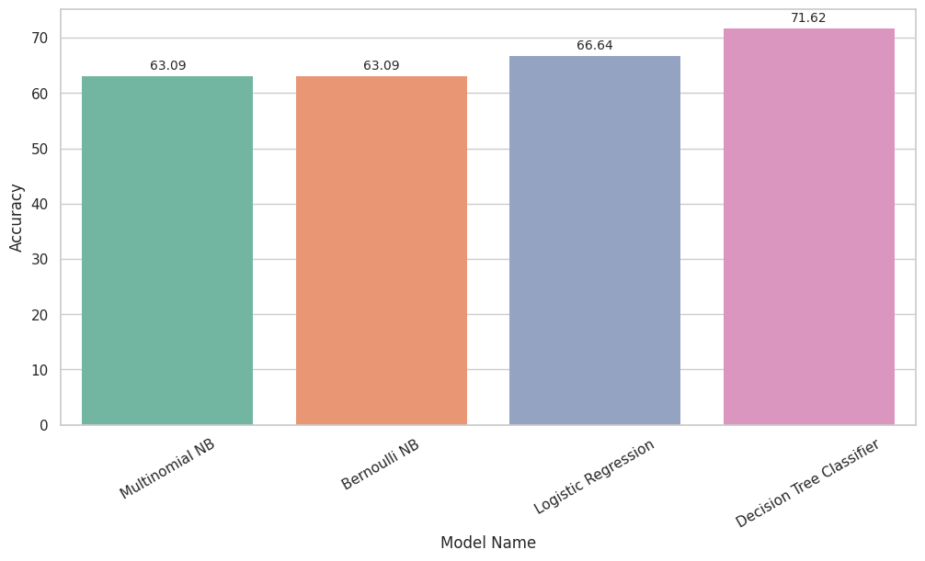
Validation accuracy comparison of different models :

Slide 17
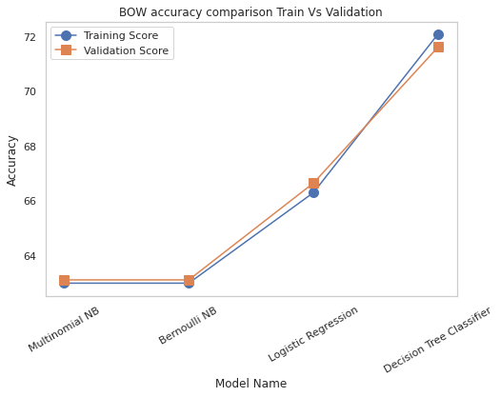
Training vs Validation score :

